Slide 1
Chapter 2
Frequency Distributions
and Graphs

Slide 2
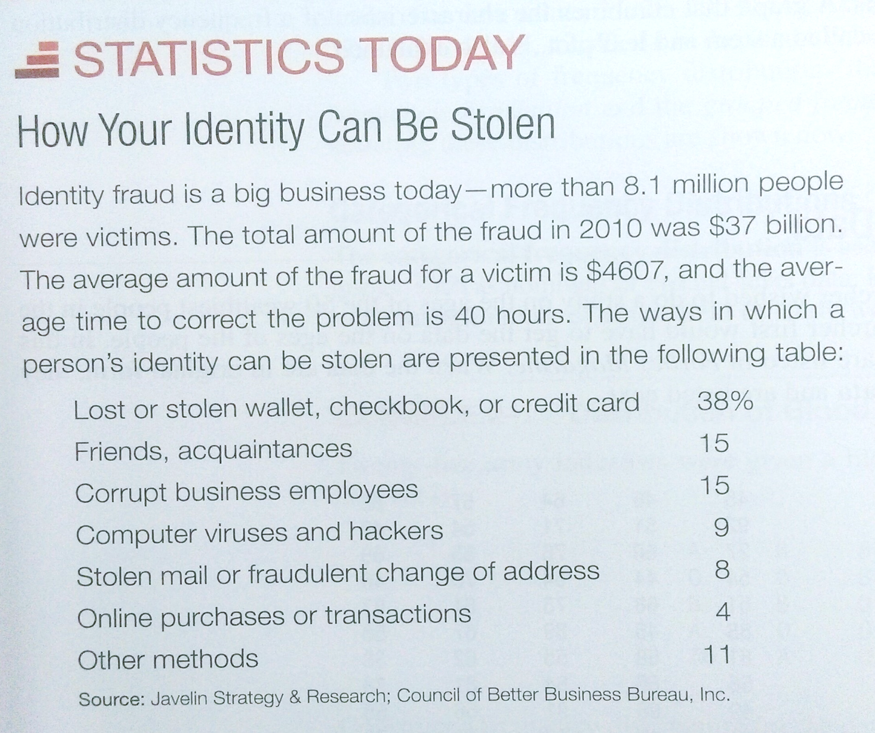

Slide 3
Chapter 2 Overview
Introduction
2-1 Organizing Data
2-2 Histograms, Frequency
Polygons, and Ogives
2-3 Other Types of Graphs

Slide 4
Chapter 2 Objectives
Organize data using frequency distributions.
Represent data in frequency distributions graphically using histograms, frequency polygons, and ogives.
Represent data using Pareto charts, time series graphs, and pie graphs.
Draw and interpret a stem and leaf plot.

Slide 6
Section 2-1
Organizing Data
Categorical Frequency Distributions
Grouped Frequency Distributions

Slide 7
Organizing Data
Raw data
Data collected in original form is called raw data.
Frequency distribution
A frequency distribution is the organization of raw data in table form, using classes and frequencies.
Categorical frequency distributions
Nominal- or ordinal-level data that can be placed in categories is organized in categorical frequency distributions.

Slide 8
Frequency Distribution
A summary of a set of data that displays the number of observations in each of the distribution’s distinct categories or classes
Is a list or a table
Contains the values of a variable (or a set of ranges within which the data fall)
Also contains the corresponding frequencies with which each value occurs (or frequencies with which data fall within each range)

Slide 9
Frequency Distribution
Developing Frequency Distribution for Discrete Data
List the possible values
Count the number of occurrences at each value
Determine the relative frequencies

Slide 10
Categorical Frequency Distribution
Example 2-1
Twenty-five army indicates were given a blood test to determine their blood type.
Raw Data:
A, B, B, AB, O, O, O, B, AB, B, B, B, O, A, O,
A, O, O, O, AB, AB, A, O, B, A
Construct a frequency distribution for the data.

Slide 11
Categorical Frequency Distribution
Twenty-five army indicates were given a blood test to determine their blood type.
Raw Data:
A, B, B, AB, O, O, O, B, AB, B, B, B, O, A, O,
A, O, O, O, AB, AB, A, O, B, A
Class | Tally | Frequency | Percent
A B O AB
IIII
IIII II
IIII IIII
IIII
5
7
9
4
20
28
36
16

Slide 12
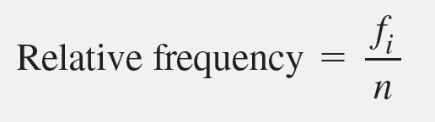
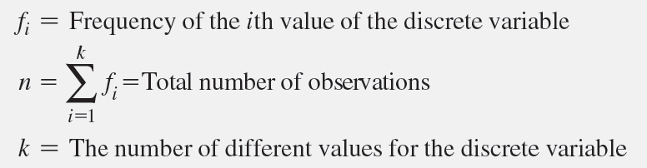
Frequency Distribution
Relative Frequency
The proportion of total observations that are in a given category.

Slide 13
Frequency Distribution
Developing Frequency Distribution for Discrete or Category Data
List the possible values
Count the number of occurrences at each value
Determine the relative frequencies

Slide 14
Example 2-2 : Numerical data Constructing a Grouped Frequency Distribution
The following data represent the record high temperatures for each of the 50 states. Construct a grouped frequency distribution for the data using 7 classes.
112 100 127 120 134 118 105 110 109 112
110 118 117 116 118 122 114 114 105 109
107 112 114 115 118 117 118 122 106 110
116 108 110 121 113 120 119 111 104 111
120 113 120 117 105 110 118 112 114 114

Slide 15
Constructing a Grouped Frequency Distribution
Class Limits | Class Boundaries | Frequency | Cumulative Frequency
100 - 104 105 - 109 110 - 114 115 - 119 120 - 124 125 - 129 130 - 134
99.5 - 104.5
104.5 - 109.5
109.5 - 114.5
114.5 - 119.5
119.5 - 124.5
124.5 - 129.5
129.5 - 134.5
2
8
18
13
7
1
1
2
10
28
41
48
49
50

Slide 16
Constructing a Grouped Frequency Distribution
STEP 1 Determine the classes.
STEP 2 Tally the data.
STEP 3 Find the frequencies.
STEP 4 Find the cumulative frequencies

Slide 17
Constructing a Grouped Frequency Distribution
STEP 1 Determine the classes.
Find the class width by dividing the range by the number of classes 7.
Range = High – Low
= 134 – 100 = 34
Width = Range/7 = 34/7 = 5
Rounding Rule: Always round up if a remainder.

Slide 18
Constructing a Grouped Frequency Distribution
For convenience sake, we will choose the lowest data value, 100, for the first lower class limit.
The subsequent lower class limits are found by adding the width to the previous lower class limits.
Class Limits
100 -
105 -
110 -
115 -
120 -
125 -
130 -
The first upper class limit is one less than the next lower class limit.
The subsequent upper class limits are found by adding the width to the previous upper class limits.
104
109
114
119
124
129
134

Slide 19
Constructing a Grouped Frequency Distribution
The class boundary is midway between an upper class limit and a subsequent lower class limit. 104,104.5,105
Class Limits | Class Boundaries | Frequency | Cumulative Frequency
100 - 104 105 - 109 110 - 114 115 - 119 120 - 124 125 - 129 130 - 134
99.5 - 104.5
104.5 - 109.5
109.5 - 114.5
114.5 - 119.5
119.5 - 124.5
124.5 - 129.5
129.5 - 134.5

Slide 20
Constructing a Grouped Frequency Distribution
STEP 2 Tally the data.
STEP 3 Find the frequencies.
Class Limits | Class Boundaries | Frequency | Cumulative Frequency
100 - 104 105 - 109 110 - 114 115 - 119 120 - 124 125 - 129 130 - 134
99.5 - 104.5
104.5 - 109.5
109.5 - 114.5
114.5 - 119.5
119.5 - 124.5
124.5 - 129.5
129.5 - 134.5
2
8
18
13
7
1
1

Slide 21
Constructing a Grouped Frequency Distribution
STEP 4 Find the cumulative frequencies by keeping a running total of the frequencies.
Class Limits | Class Boundaries | Frequency | Cumulative Frequency
100 - 104 105 - 109 110 - 114 115 - 119 120 - 124 125 - 129 130 - 134
99.5 - 104.5
104.5 - 109.5
109.5 - 114.5
114.5 - 119.5
119.5 - 124.5
124.5 - 129.5
129.5 - 134.5
2
8
18
13
7
1
1
2
10
28
41
48
49
50

Slide 22
Grouped Frequency Distribution
Grouped frequency distributions
when the range of the data is large.
Class limits & Class boundaries
The smallest and largest possible data values in a class are the lower and upper class limits.
Class boundaries separate the classes.
Find a class boundary
average the upper class limit of one class and the lower class limit of the next class.

Slide 23
Grouped Frequency Distribution
The class width can be calculated by subtracting
successive lower class limits (or boundaries)
successive upper class limits (or boundaries)
upper and lower class boundaries
The class midpoint X_{m} can be calculated by averaging
upper and lower class limits (or boundaries)

Slide 24
Rules for Classes in Grouped Frequency Distributions
There should be 5-20 classes.
The class width should be an odd number.
The classes must be mutually exclusive.
The classes must be continuous.
The classes must be exhaustive.
The classes must be equal in width (except in open-ended distributions).

Slide 25
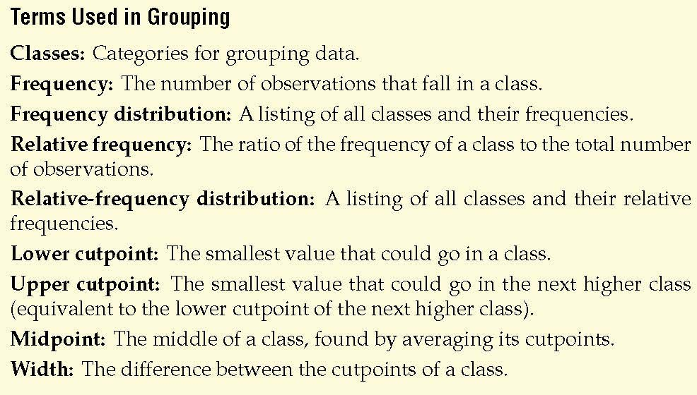
Definition
參考資料: Weiss, Chapter 2
Notes:
Change to page 49

Slide 26
Grouped Data Frequency Dist.
Continuous data
data whose possible values are uncountable and that may assume any value in an interval (weight, length, time)
Discrete data with many possible outcomes (age, income, stock price)
Summarized in a grouped data frequency distribution
Data are organized in classes

Slide 27
Grouped Data Frequency Dist.
Criteria for Building Classes
Classes must be mutually exclusive
Classes do not overlap
Classes must be all-inclusive
Classes should be of equal width, if possible
the distance between the lowest and the highest possible values in each class is equal for all classes.
Empty classes should be avoided

Slide 28
Frequency Distributions
Developing Frequency Distribution for Continuous Data
Determine the number of classes
Establish the class width
Determine the class boundaries for each class the upper and lower values of each class
Determine the class frequency for each class number of data points in each class

Slide 29
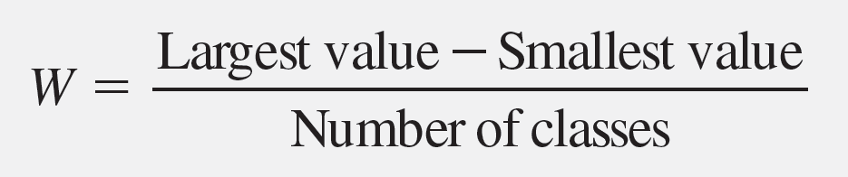
Frequency Distributions
Grouped Data
How Many Classes?
Rule of thumb: between 5 and 20 classes
2^{k} ≥ n rule,
The minimum class width:

Slide 30
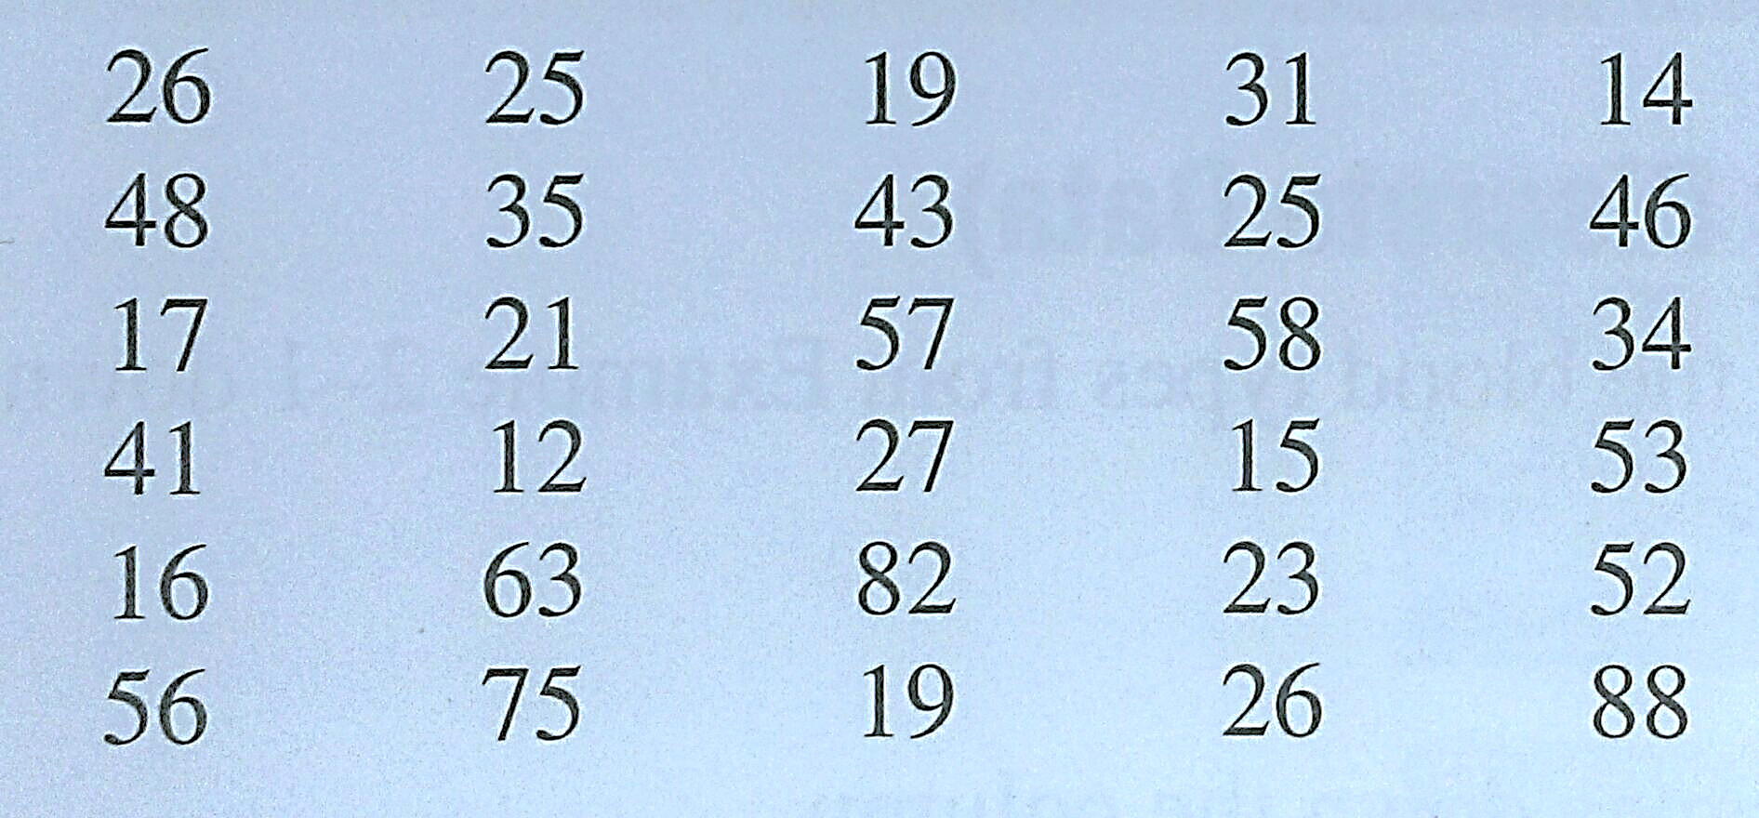
Exercise
Construct a frequency distribution for the data using 9 classes.

Slide 31
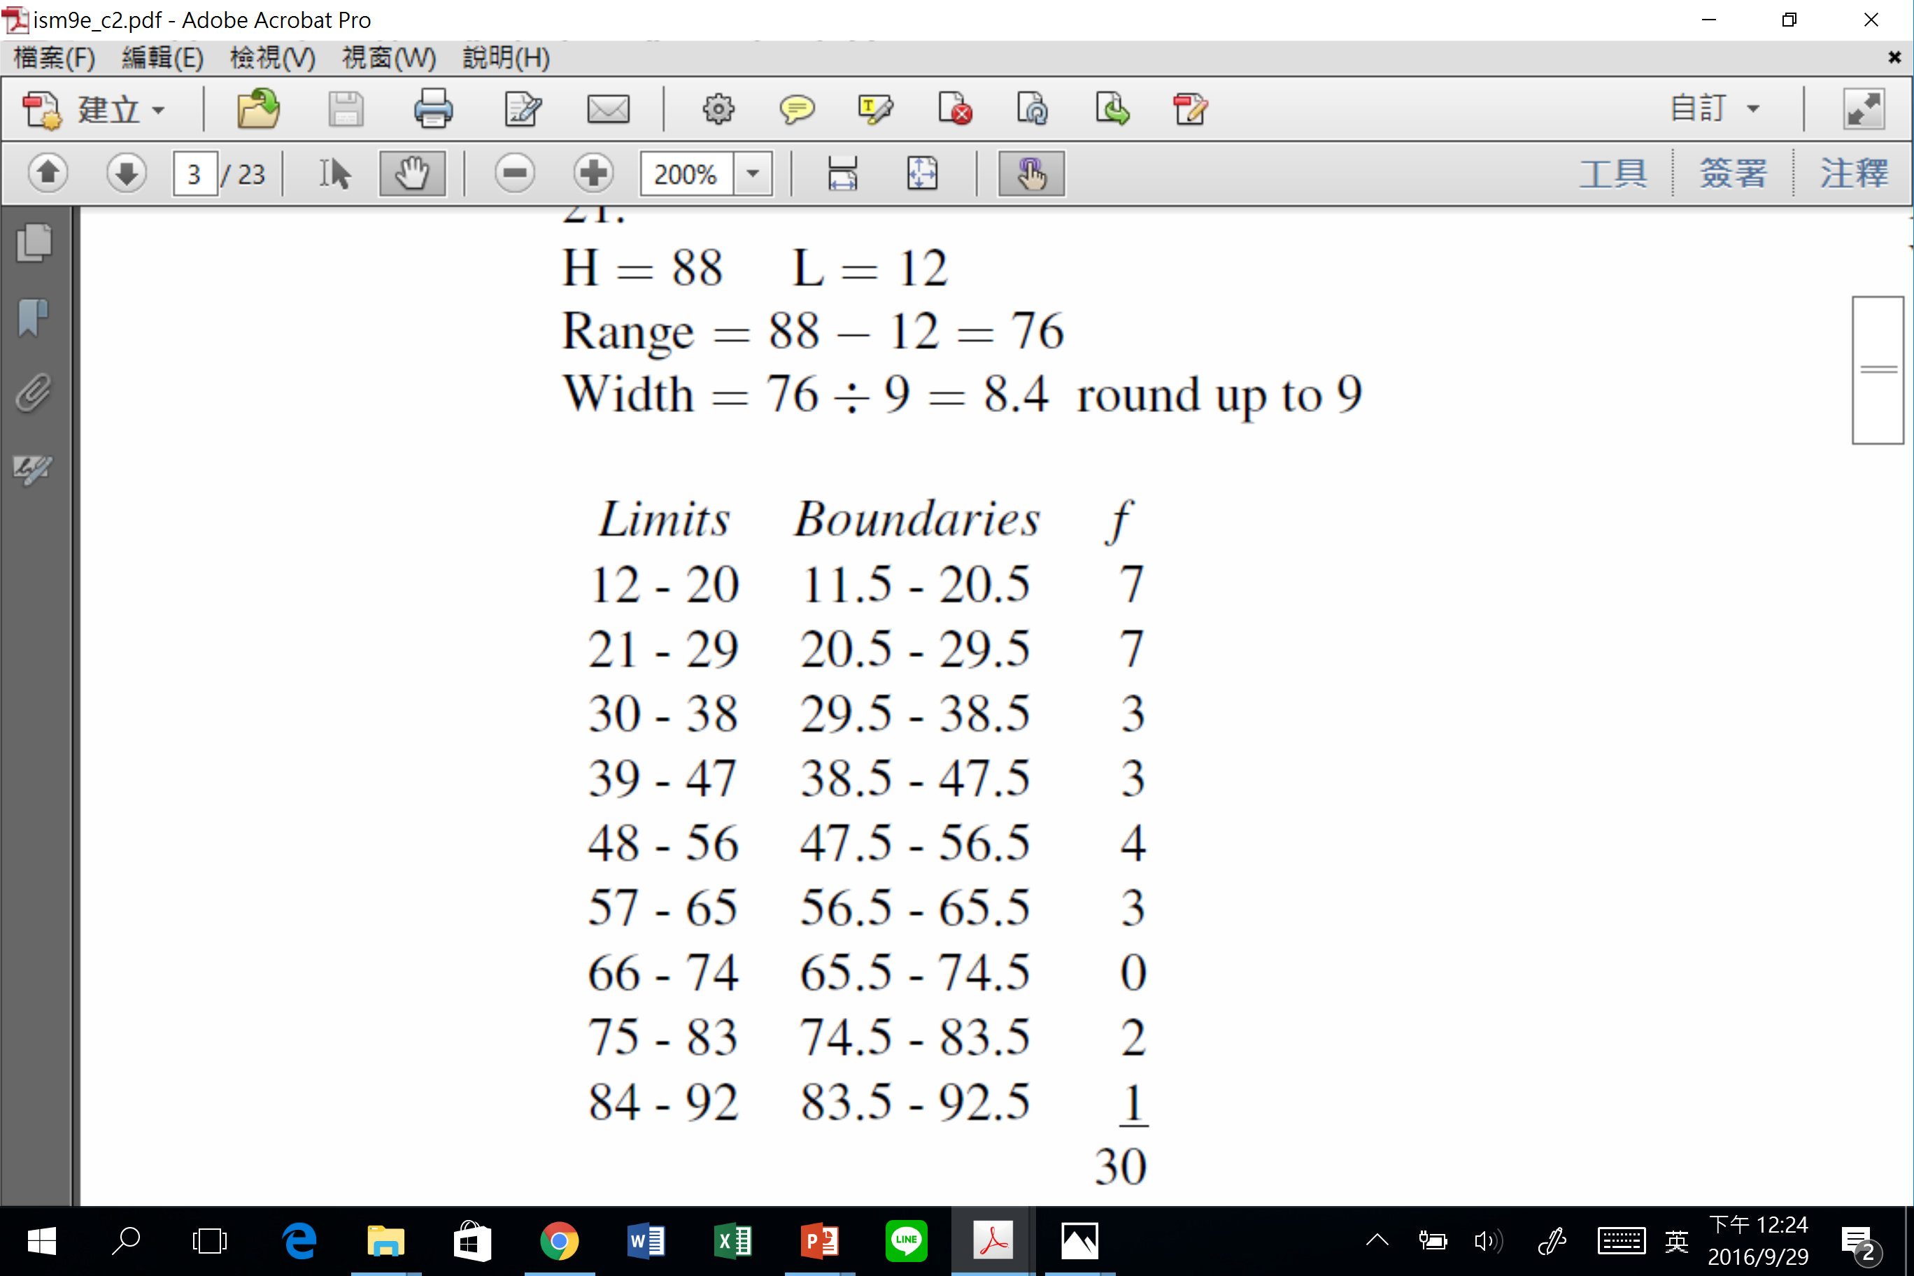
Solution
Limits | Boundaries | Frequency
 | Total | 30

Slide 32
Section 2-2
Histograms, Frequency Polygons, and Ogives

Slide 33
3 Most Common Graphs in Research
Histogram
Frequency Polygon
Cumulative Frequency Polygon (Ogive)

Slide 34
Histograms
The histogram is a graph that displays the data by using vertical bars of various heights to represent the frequencies of the classes.
The class boundaries are represented on the horizontal axis.

Slide 35
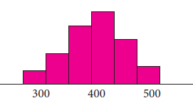
Histograms
Frequency Histograms
A graph of a frequency distribution with the horizontal axis showing the classes, the vertical axis showing the frequency count, and (for equal class widths) the rectangles having a height equal to the frequency in each class.
40 50 60 70 80 90

Slide 36
Histograms
Constructing Frequency Histograms
Construct a frequency distribution
Construct the axes for the histogram
Construct bars with heights corresponding to the frequency of each class
Label the histogram appropriately

Slide 37
Example 2-4 Histograms
Construct a histogram to represent the data for the record high temperatures for each of the 50 states (see Example 2–2 for the data).
112 100 127 120 134 118 105 110 109 112
110 118 117 116 118 122 114 114 105 109
107 112 114 115 118 117 118 122 106 110
116 108 110 121 113 120 119 111 104 111
120 113 120 117 105 110 118 112 114 114

Slide 38
Example 2-4 (Page #57) Histograms
Histograms use class boundaries and frequencies of the classes.
Class Limits | Class Boundaries | Frequency
100 - 104 105 - 109 110 - 114 115 - 119 120 - 124 125 - 129 130 - 134
99.5 - 104.5
104.5 - 109.5
109.5 - 114.5
114.5 - 119.5
119.5 - 124.5
124.5 - 129.5
129.5 - 134.5
2
8
18
13
7
1
1

Slide 39
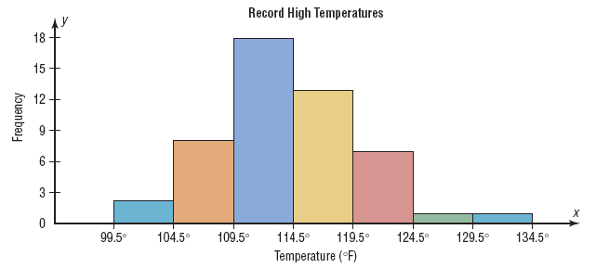
Histograms
Histograms use class boundaries and frequencies of the classes.
x

Slide 40
Frequency Polygons
The frequency polygon is a graph that displays the data by using lines that connect points plotted for the frequencies at the class midpoints. The frequencies are represented by the heights of the points.
The class midpoints are represented on the horizontal axis.

Slide 41
Example 2-5 (Page #58) Frequency Polygons
Construct a frequency polygon to represent the data for the record high temperatures for each of the 50 states (see Example 2–2 for the data).
112 100 127 120 134 118 105 110 109 112
110 118 117 116 118 122 114 114 105 109
107 112 114 115 118 117 118 122 106 110
116 108 110 121 113 120 119 111 104 111
120 113 120 117 105 110 118 112 114 114

Slide 42
Frequency Polygons
Frequency polygons use class midpoints and frequencies of the classes.
Class boundaries | Class Midpoints | Frequency
99.5 – 104.5 104.5 – 109.5 109.5 – 114.5 114.5 – 119.5 119.5 – 124.5 124.5 – 129.5 129.5 – 134.5
102
107
112
117
122
127
132
2
8
18
13
7
1
1

Slide 43
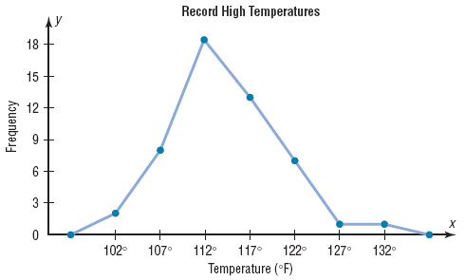
Frequency Polygons
Frequency polygons use class midpoints and frequencies of the classes.
A frequency polygon
is anchored on the
x-axis before the first
class and after the
last class.

Slide 44
Ogives
The ogive is a graph that represents the cumulative frequencies for the classes in a frequency distribution.
The upper class boundaries are represented on the horizontal axis.

Slide 45
Example 2-6 (Page #59) Ogives
Construct an ogive to represent the data for the record high temperatures for each of the 50 states (see Example 2–2 for the data).
112 100 127 120 134 118 105 110 109 112
110 118 117 116 118 122 114 114 105 109
107 112 114 115 118 117 118 122 106 110
116 108 110 121 113 120 119 111 104 111
120 113 120 117 105 110 118 112 114 114

Slide 46
Ogives
Ogives use upper class boundaries and cumulative frequencies of the classes.
Class Limits | Class Boundaries | Frequency | Cumulative Frequency
100 - 104 105 - 109 110 - 114 115 - 119 120 - 124 125 - 129 130 - 134
99.5 - 104.5
104.5 - 109.5
109.5 - 114.5
114.5 - 119.5
119.5 - 124.5
124.5 - 129.5
129.5 - 134.5
2
8
18
13
7
1
1
2
10
28
41
48
49
50

Slide 47
Ogives
Ogives use upper class boundaries and cumulative frequencies of the classes.
Class Boundaries | Cumulative Frequency
Less than 104.5
Less than 109.5
Less than 114.5
Less than 119.5
Less than 124.5
Less than 129.5
Less than 134.5
2
10
28
41
48
49
50

Slide 48
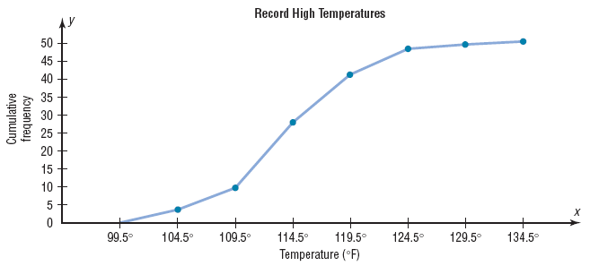
Ogives
Ogives use upper class boundaries and cumulative frequencies of the classes.

Slide 49
Procedure--Constructing Statistical Graphs
1: Draw and label the x and y axes.
2: Choose a suitable scale for the frequencies or cumulative frequencies, and label it on the y axis.
3: Represent the class boundaries for the histogram or ogive, or the midpoint for the frequency polygon, on the x axis.
4: Plot the points and then draw the bars or lines.

Slide 50
Relative frequency graphs
If proportions are used instead of frequencies, the graphs are called relative frequency graphs.
Relative frequency graphs are used when the proportion of data values that fall into a given class is more important than the actual number of data values that fall into that class.

Slide 51
Example 2-7 (Page #61)
Frequency Distributions and Graphs
Construct a histogram, frequency polygon, and ogive using relative frequencies for the distribution (shown here) of the miles that 20 randomly selected runners ran during a given week.
Class Boundaries | Frequency
5.5 - 10.5 10.5 - 15.5 15.5 - 20.5 20.5 - 25.5 25.5 - 30.5 30.5 - 35.5 35.5 - 40.5
1
2
3
5
4
3
2

Slide 52
Histograms
The following is a frequency distribution of miles run per week by 20 selected runners.
Class Boundaries | Frequency | Relative Frequency
5.5 - 10.5 10.5 - 15.5 15.5 - 20.5 20.5 - 25.5 25.5 - 30.5 30.5 - 35.5 35.5 - 40.5
Divide each frequency by the total frequency to get the relative frequency.
1
2
3
5
4
3
2
1/20 =
2/20 =
3/20 =
5/20 =
4/20 =
3/20 =
2/20 =
0.05
0.10
0.15
0.25
0.20
0.15
0.10
Σf = 20
Σrf = 1.00

Slide 53
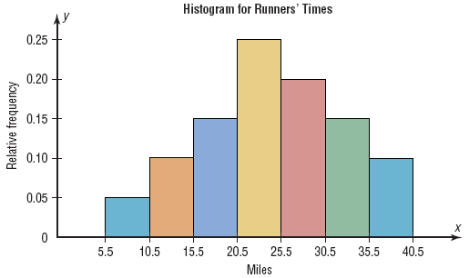
Histograms
Use the class boundaries and the relative frequencies of the classes.

Slide 54
Frequency Polygons
The following is a frequency distribution of miles run per week by 20 selected runners.
Class Boundaries | Class Midpoints | Relative Frequency
5.5 - 10.5 10.5 - 15.5 15.5 - 20.5 20.5 - 25.5 25.5 - 30.5 30.5 - 35.5 35.5 - 40.5
8
13
18
23
28
33
38
0.05
0.10
0.15
0.25
0.20
0.15
0.10

Slide 55
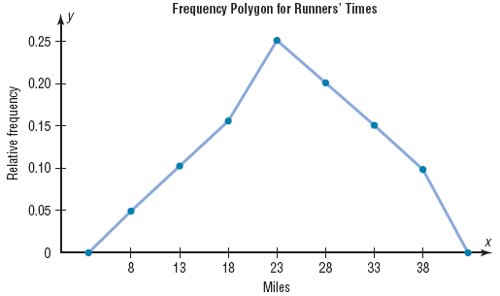
Frequency Polygons
Use the class midpoints and the relative frequencies of the classes.

Slide 56
Ogives
The following is a frequency distribution of miles run per week by 20 selected runners.
Class Boundaries | Frequency | Cumulative Frequency | Cum. Rel. Frequency
5.5 - 10.5 10.5 - 15.5 15.5 - 20.5 20.5 - 25.5 25.5 - 30.5 30.5 - 35.5 35.5 - 40.5
1
2
3
5
4
3
2
1
3
6
11
15
18
20
1/20 =
3/20 =
6/20 =
11/20 =
15/20 =
18/20 =
20/20 =
0.05
0.15
0.30
0.55
0.75
0.90
1.00
Σf = 20

Slide 57
Ogives
Ogives use upper class boundaries and cumulative frequencies of the classes.
Class Boundaries | Cum. Rel. Frequency
Less than 10.5
Less than 15.5
Less than 20.5
Less than 25.5
Less than 30.5
Less than 35.5
Less than 40.5
0.05
0.15
0.30
0.55
0.75
0.90
1.00

Slide 58
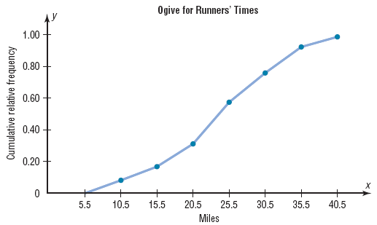
Ogives
Use the upper class boundaries and the cumulative relative frequencies.

Slide 59
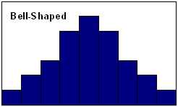
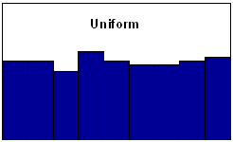
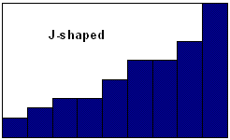
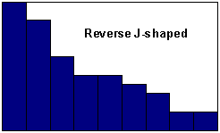
Shapes of Distributions

Slide 60
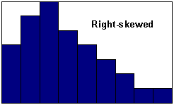
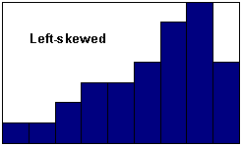
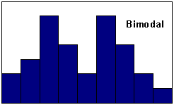
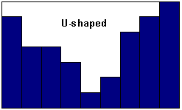
Shapes of Distributions

Slide 61
Section 2-3
Other Types of Graphs

Slide 62
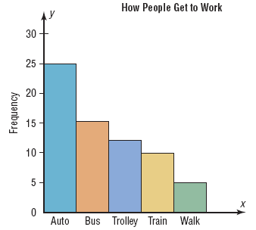
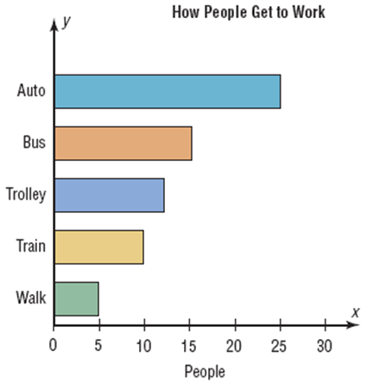
Bar Graphs
Pareto Charts

Slide 63
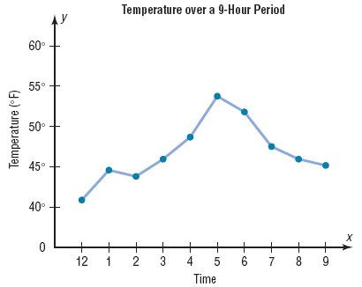
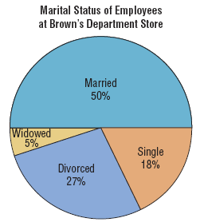
Time Series Graphs
Pie Graphs

Slide 64
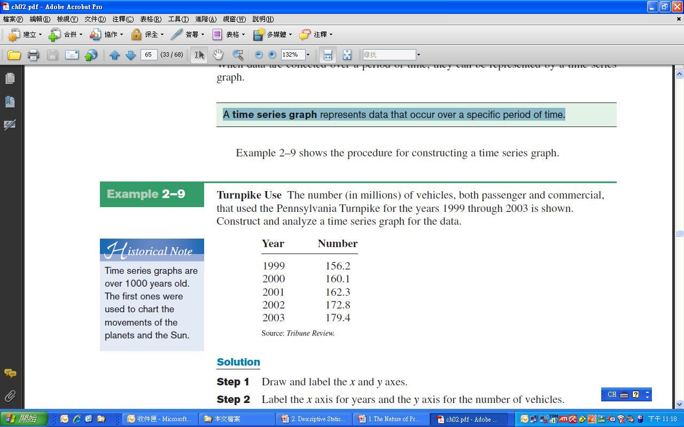
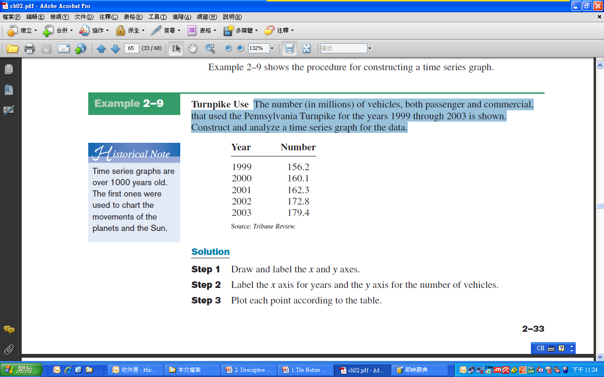
The Time Series Graph
A time series graph represents data that occur over a specific period of time.
The number (in millions) of vehicles, both passenger and commercial, that used the Pennsylvania Turnpike for the years 1999 through 2003 is shown.
Construct and analyze a time series graph for the data.

Slide 65
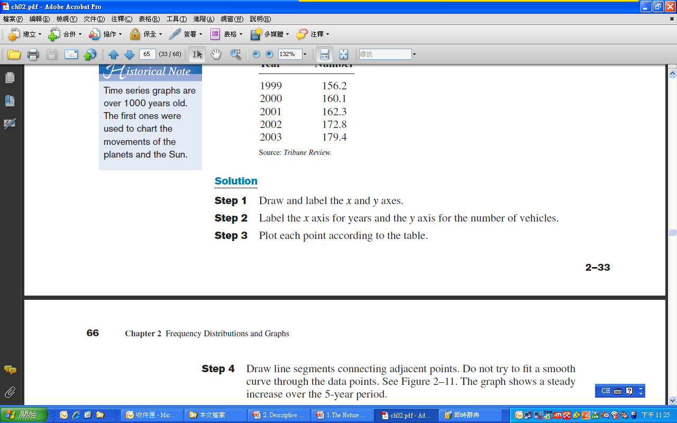
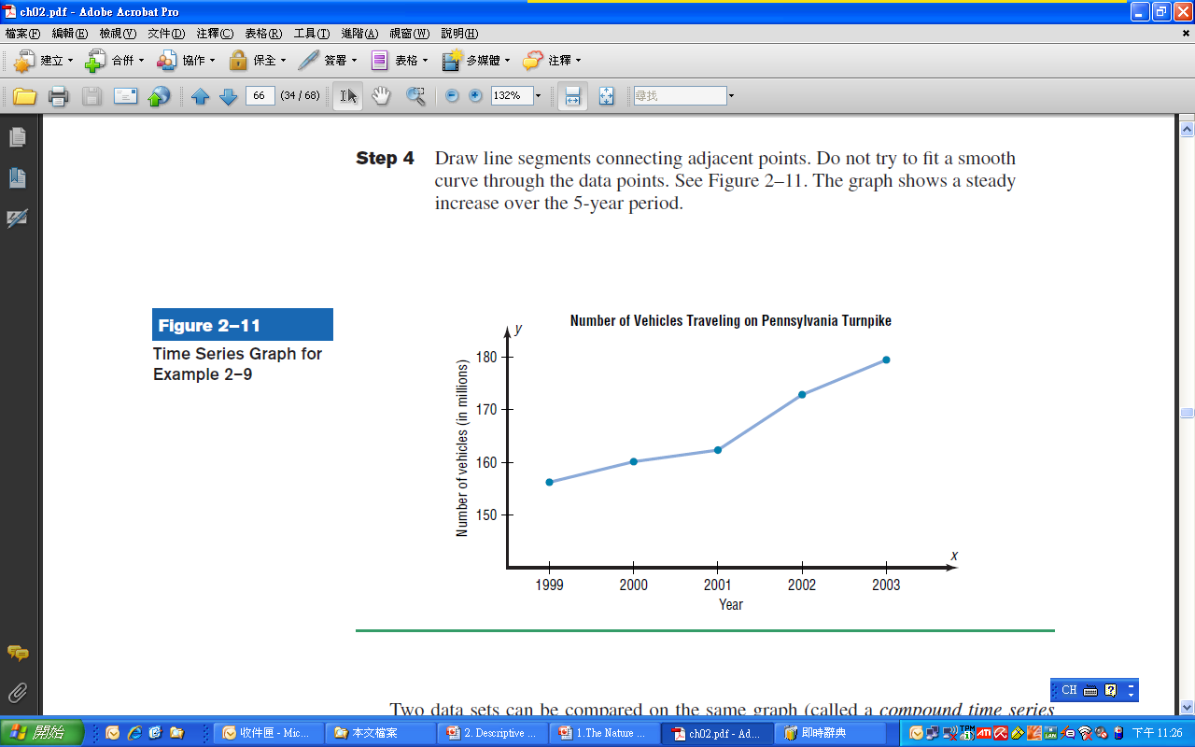

Slide 66
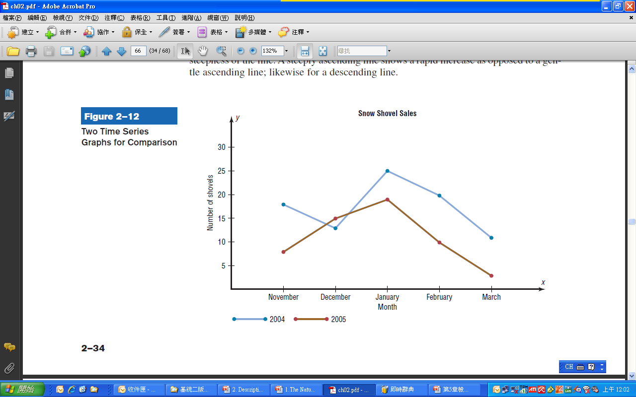

Slide 67
Pie Graph
To show the relationship of the parts to the whole by visually comparing the sizes of the sections
The variable is nominal or categorical.
Percentages or proportions can be used.
Pei graph is a circle that is divided into sections or wedges according to the percentage of frequencies in each category of the distribution.

Slide 68
Example: Pei graph
Construct a pie graph showing the blood types of the army inductees described in Example 2–1. The frequency distribution is repeated here.
Class | Tally | Frequency | Percent
A B O AB
IIII
IIII II
IIII IIII
IIII
5
7
9
4
20
35
45
16

Slide 69
Solution:
Step 1 Find the number of degrees for each class,
using the formula
Step 2 Find the percentages.
Step 3 Graph each section and write its name and
corresponding percentage.
Class | Frequency | Degrees | Percent
A B O AB
5
7
9
4
72
100.8
129.6
57.6
20
28
36
16

Slide 70
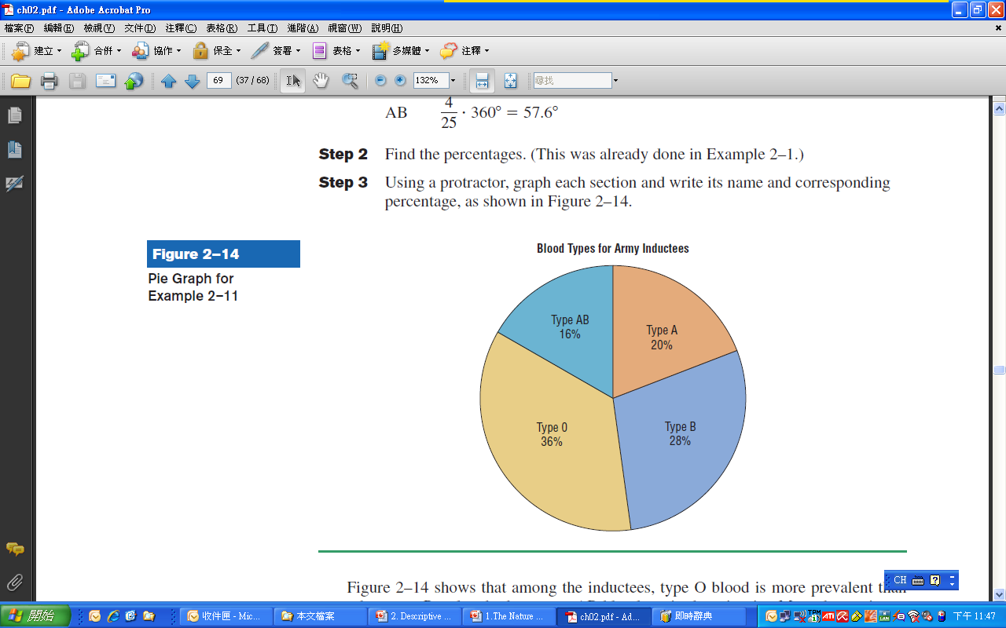

Slide 71
林惠玲 陳正倉著 雙葉書廊發行 2008

Slide 72
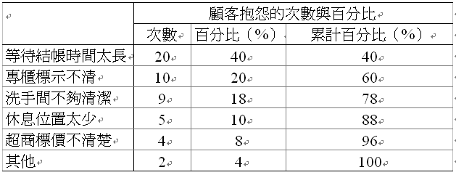
顧客抱怨的項目
林惠玲 陳正倉著 雙葉書廊發行 2008

Slide 73
顧客抱怨的Pareto圖

Slide 74
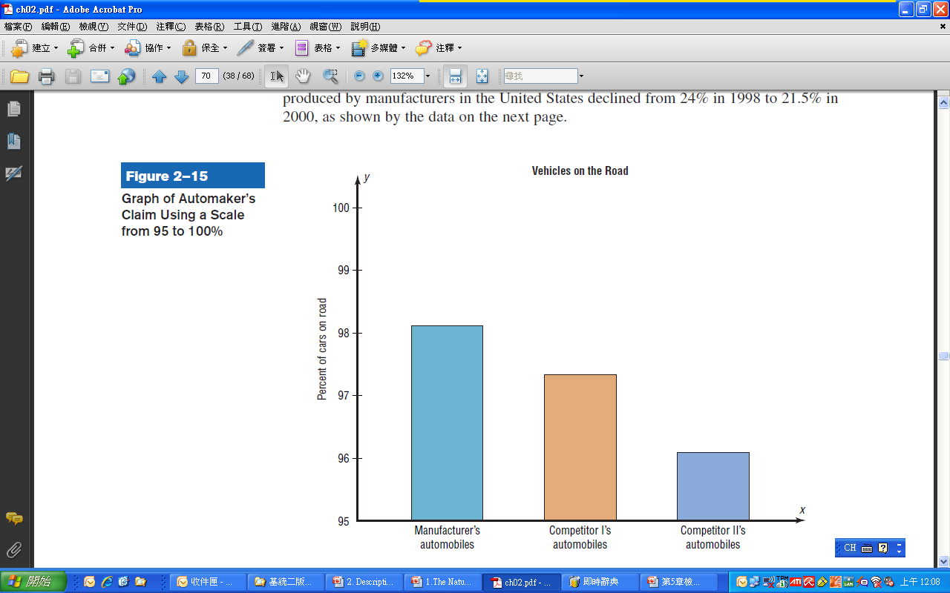
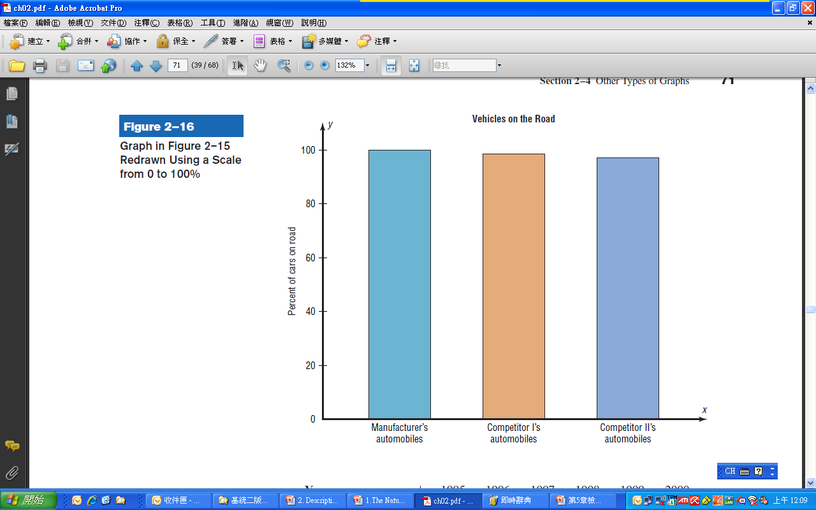
Misleading Graphs -1/4

Slide 75
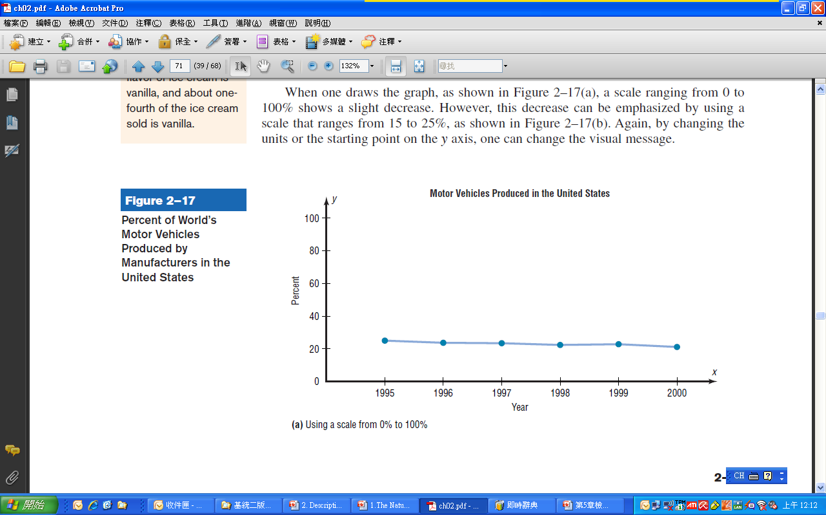
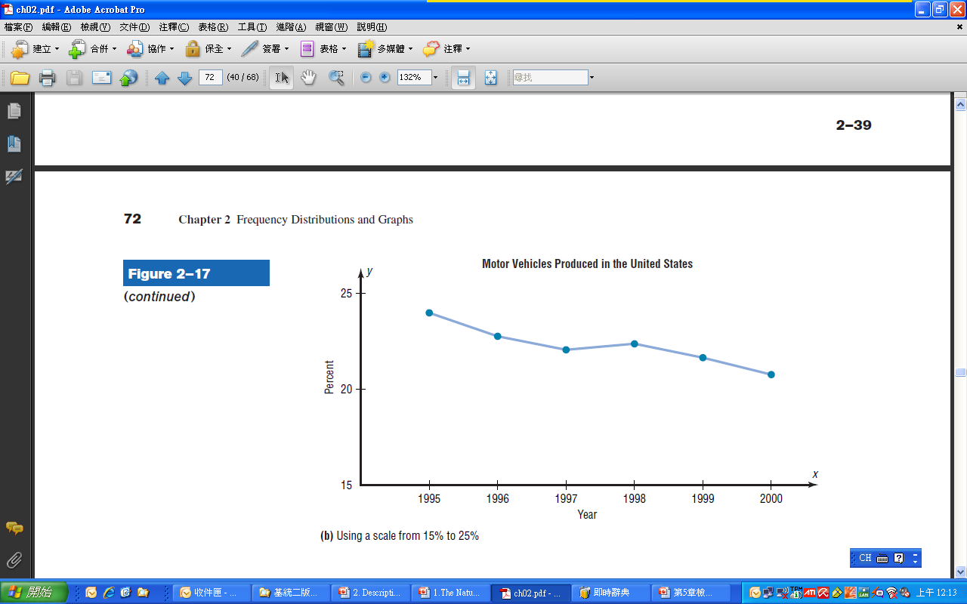
Misleading Graphs -2/4

Slide 76
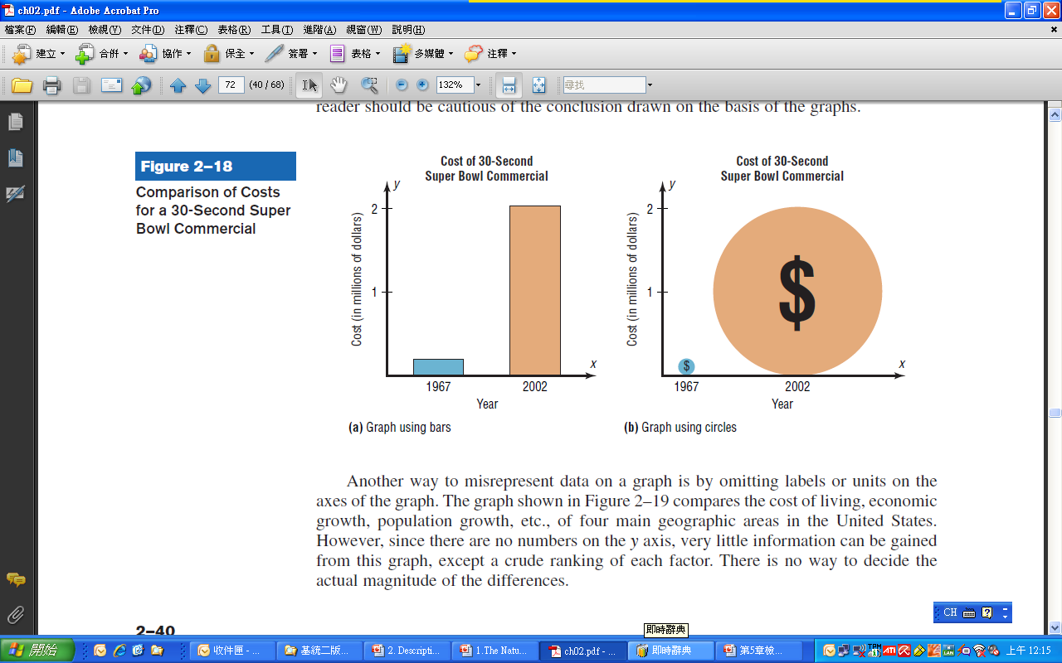
Misleading Graphs -3/4

Slide 77
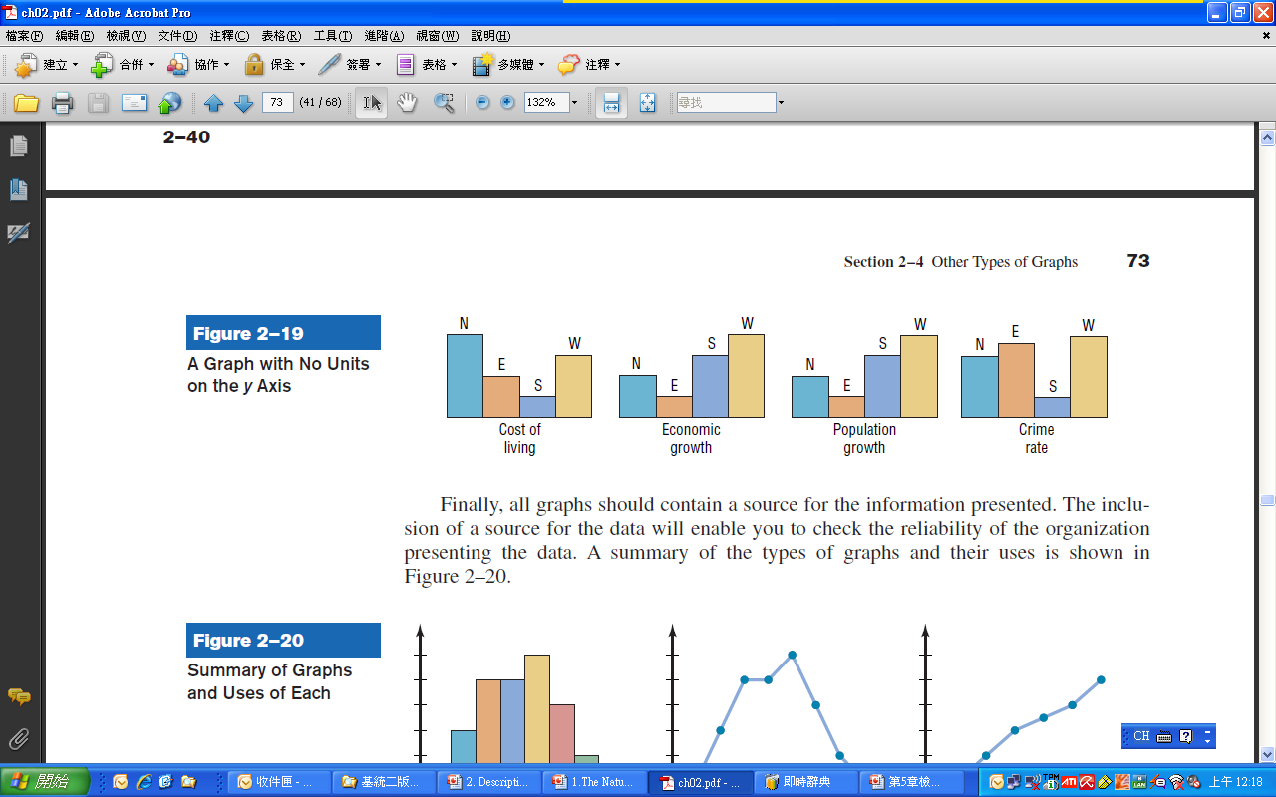

Misleading Graphs -4/4

Slide 78
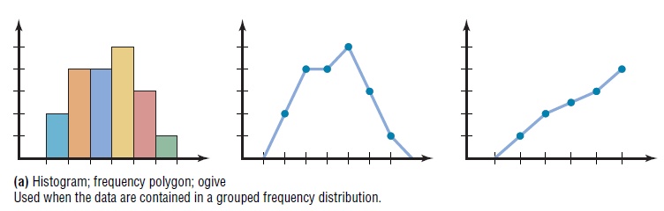
Summary of Graphs and Uses-1/2

Slide 79

Summary of Graphs and Uses-2/2

Slide 80
Stem and Leaf Plots
A stem and leaf plots is a data plot that uses part of a data value as the stem and part of the data value as the leaf to form groups or classes.
It has the advantage over grouped frequency distribution of retaining the actual data while showing them in graphic form.

Slide 81
Example 2-14 (Page #84)
stem and leaf plot
At an outpatient testing center, the number of cardiograms performed each day for 20 days is shown. Construct a stem and leaf plot for the data.
25 31 20 32 13
14 43 2 57 23
36 32 33 32 44
32 52 44 51 45

Slide 82
25 31 20 32 13
14 43 2 57 23
36 32 33 32 44
32 52 44 51 45
Unordered Stem Plot
Ordered Stem Plot
0
2
0 | 2
1 | 3 | 4
2 | 0 | 3 | 5
3 | 1 | 2 | 2 | 2 | 2 | 3 | 6
4 | 3 | 4 | 4 | 5
5 | 1 | 2 | 7
1
3
4
2
5
0
3
3
1
2
6
2
3
2
2
4
3
4
4
5
5
7
2
1

Slide 83
Supplement-- Paired Data and Scatter Plots
A scatter plot is a graph of order pairs of data values that is used to determine if a relationship exists between the two variables.

Slide 84
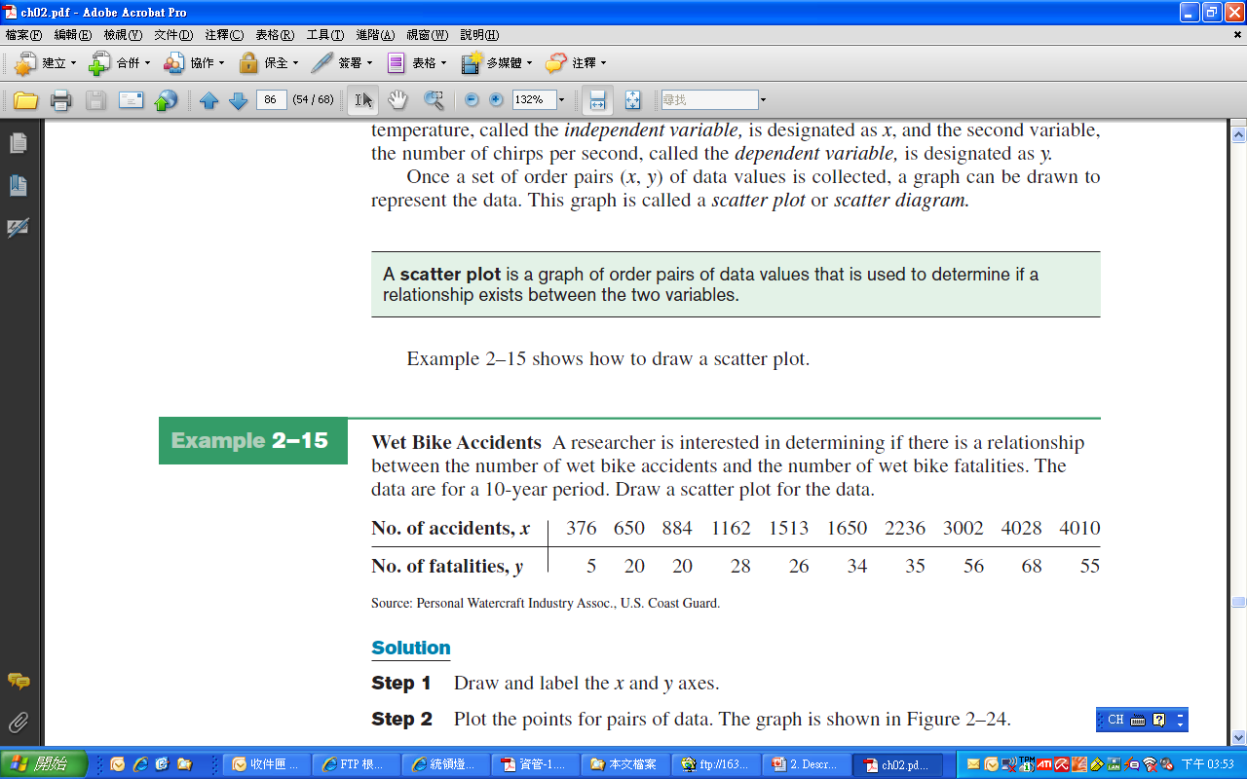
Example: Paired Data and Scatter Plots
Wet Bike Accidents
A researcher is interested in determining if there is a relationship
between the number of wet bike accidents and the number of wet bike fatalities. The data are for a 10-year period.
Draw a scatter plot for the data.

Slide 85
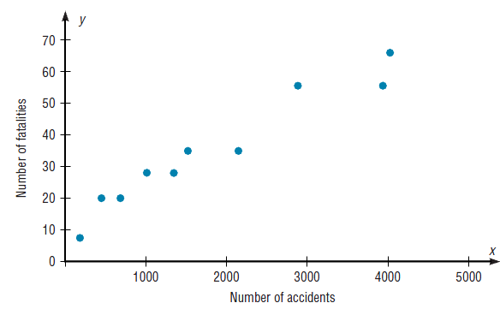
Solution
Step 1 Draw and label the x and y axes.
Step 2 Plot the points for pairs of data.

Slide 86
Analyzing the Scatter Plot
Positive linear relationship
The points fall approximately in an ascending straight line and both the x and y values increase at the same time
Negative linear relationship
The points fall approximately in a descending straight line from left to right
Nonlinear relationship
The points fall in a curved line
No relationship
There is no discernable pattern of the points

Slide 87
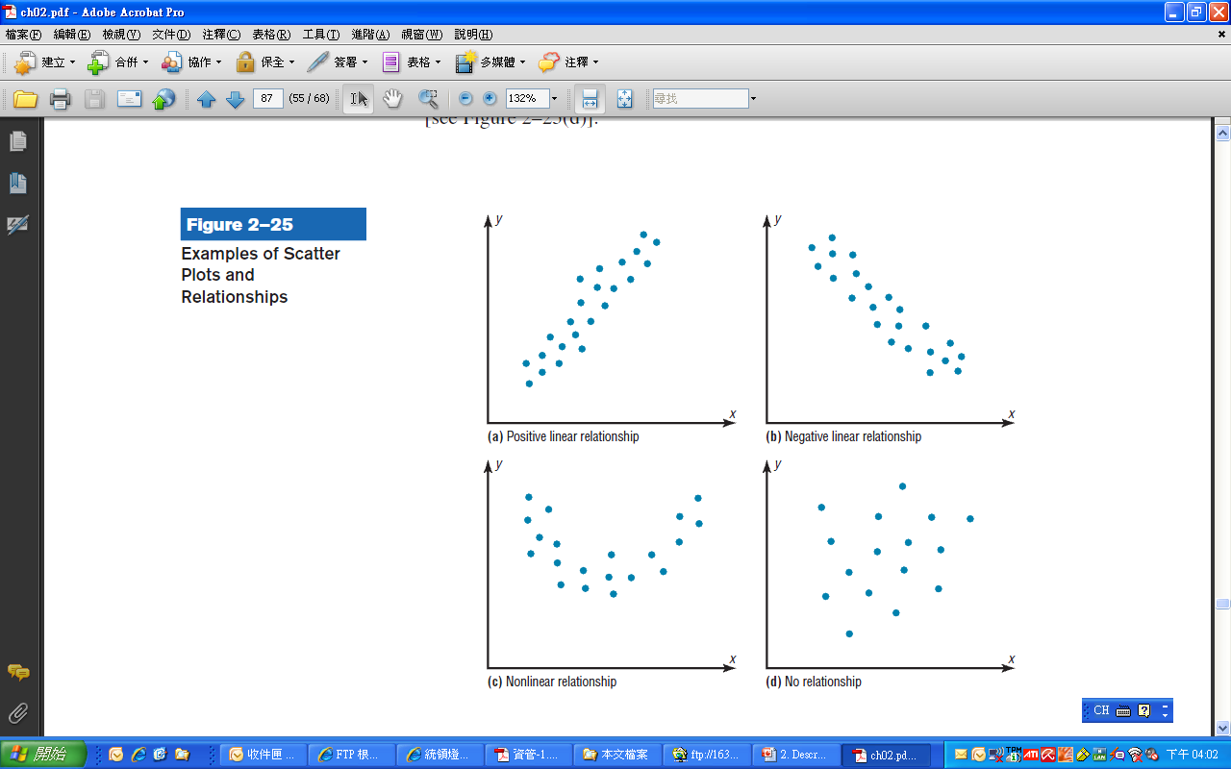

Slide 88
Exercises
Section 2-1 (p.51)
#1, 10, 14, 23
Section 2-2 (p.65)
#6, #7, #16,#18, #21
Section 2-3 (p.90)
#4, #7, #10, #17, #27
Review Exercises
#4, #6, #8, #10, #12

